Slide 1
Level 4/5 Group 10
Courtney Pearson S185717
Aaron Kegge S186229
Thomas McCarthy S183168

Slide 2
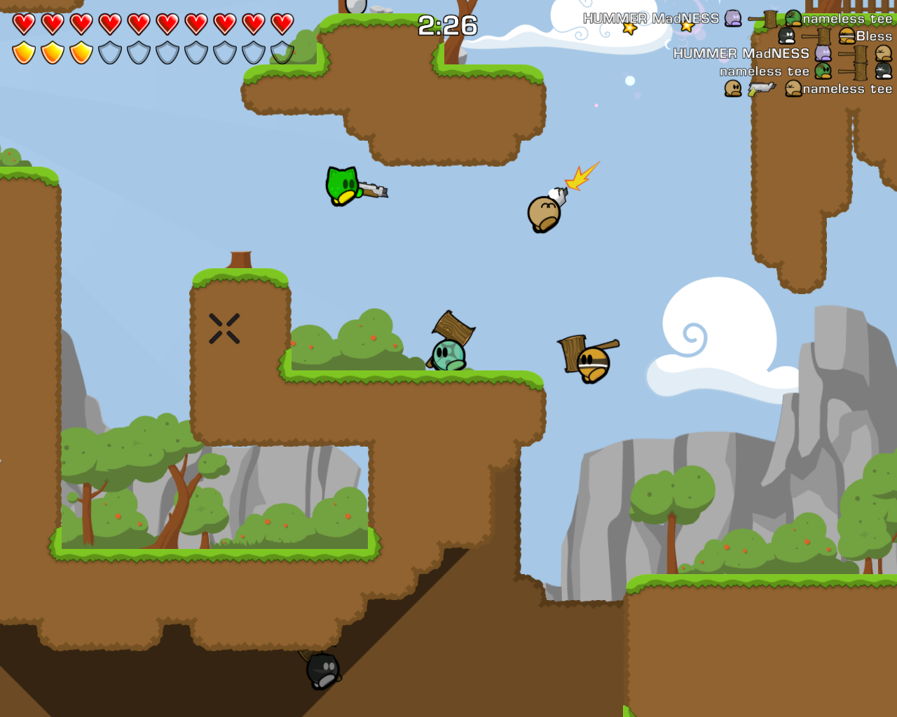
Genre / Style
2D Platformer
Pc only.
Competitive 2 players
CP

Slide 3
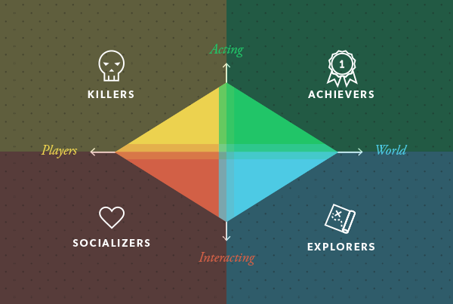
Target demographic
Socializers
+ Achievers
Age:
16+
Gender:
Males and females
TM

Slide 4
Physics
Gravity-
-Items falling.
-Players can fall off the ice.
Items stun the players.
Friction – Slippery Ice.
AK

Slide 5
Mechanics
Symmetric mechanic- Shovels.
Damage- (Falling Chickens).
Timer.
Wall jumping.
Health- Hearts.
CP

Slide 6
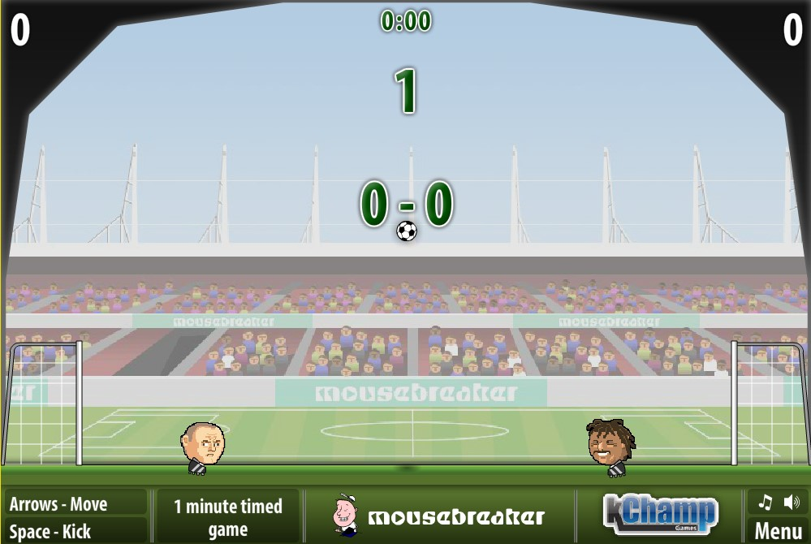
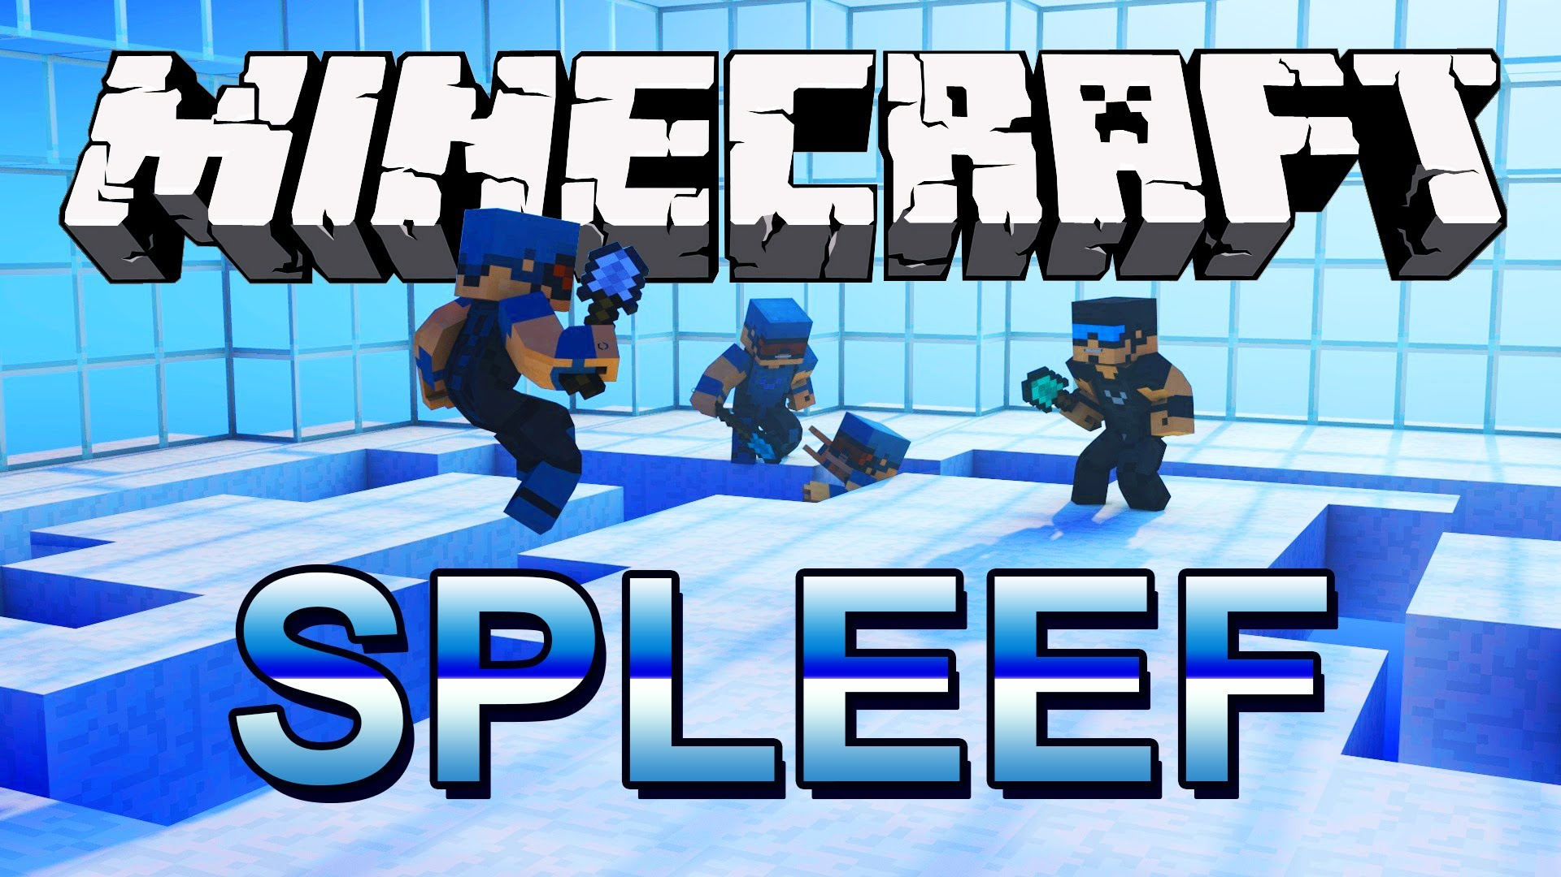
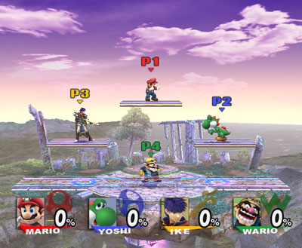
Inspired Examples
Sports heads
Minecraft spleef
Super smash bros
TM

Slide 7
What does the player do ?
Button press
Competitive – goal
Reflex –avoid damage
Fiero

Slide 8
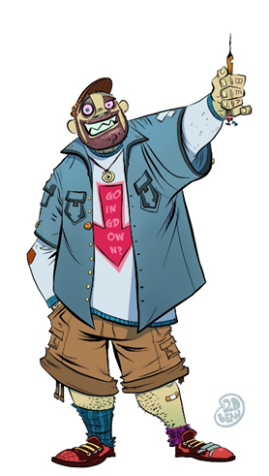
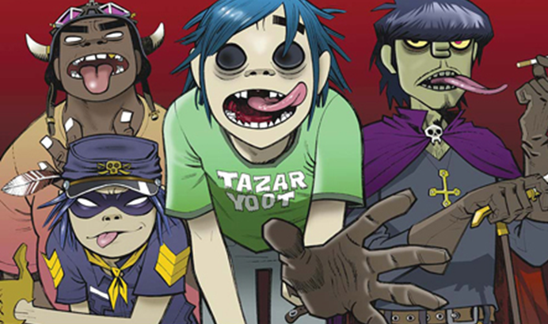
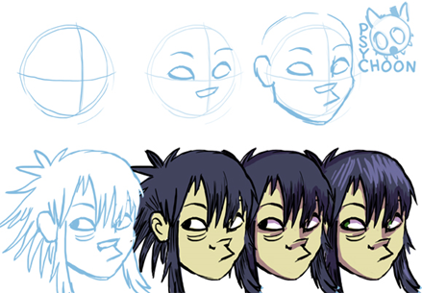
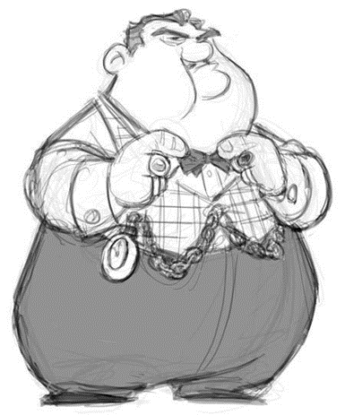

Art style
CP

Slide 9
Visual hierarchy
AK

Slide 10
Reference
http://vignette1.wikia.nocookie.net/ssb/images/b/be/SSBB_Gameplay.jpg/revision/latest?cb=20071222025033
http://sports-heads-club.co.uk/sports-heads-football2.jpg https://i.ytimg.com/vi/HiTrZNb-zEc/maxresdefault.jpg http://solargate.ru/system/files/u2/060_3_teewars.png
http://il2.picdn.net/shutterstock/videos/21422809/thumb/1.jpg http://orig05.deviantart.net/0ab8/f/2013/061/8/5/a_sort_of_process_to_draw_noodle_by_psychoon-d5wqxla.jpg http://www.phaidon.com/resource/gorillaz-cartoons-i.jpg http://orig14.deviantart.net/008f/f/2012/104/2/d/self_portrait_gorillaz_style_by_brettbbean-d4w64f7.jpg
https://s-media-cache-ak0.pinimg.com/736x/73/71/e0/7371e0faf20b02ee76c386fd5dbec665.jpg
https://cdn.tutsplus.com/gamedev/authors/michael-james-williams/Diagram.png

Slide 11
Any Questions?

